Slide 1
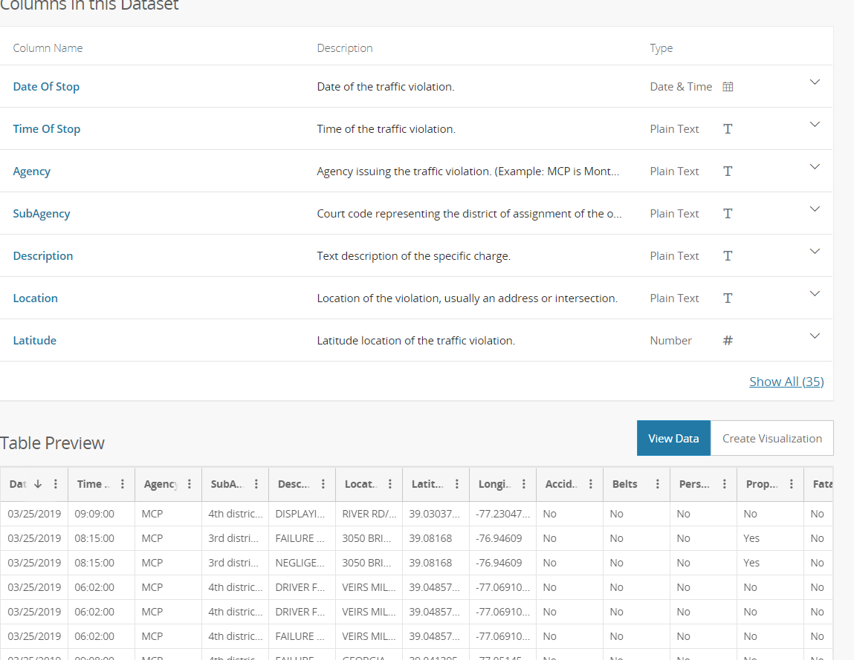
Traffic Violations - Visualization
Tell the story of how traffic violations has trended in Montgomery County across 4 years.
We will create a user driven dashboard to show the trends of violations, top 10 causes of these violations, and the impact of the violations (ie car accidents, property damage.)
The JS library Ember.js will be used.
Dataset link : https://www.kaggle.com/felix4guti/traffic-violations-in-usa
Git Hub repo : https://github.com/sigmanudude/Project2
Preview of Metadata / Data

Slide 2
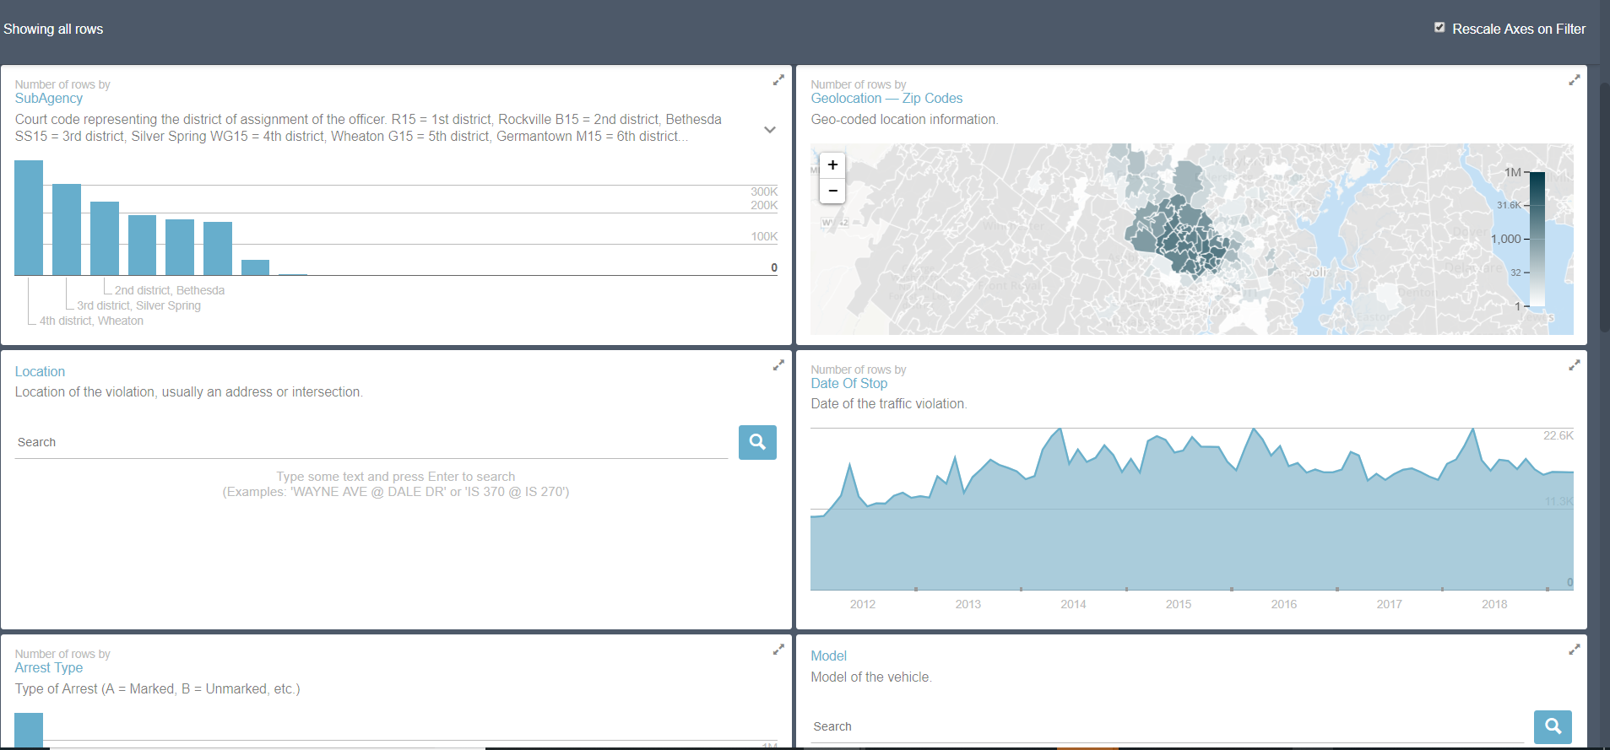
Sample screenshots

